Slide 1
Water Pollution
This presentation was completed in the Comenius project:
THE IMPORTANCE AND THE PLACE OF UNDERGROUND WATER IN HUMAN LIFE.
Prezentacja zrealizowana w ramach projektu Comenius:
MIEJSCE I ZNACZENIE WÓD PODZEIMNYCH W ŻYCIU LUDZKIM.
By Dominika Karczmarczyk
Zespół Szkół nr 43 w Warszawie

Slide 2
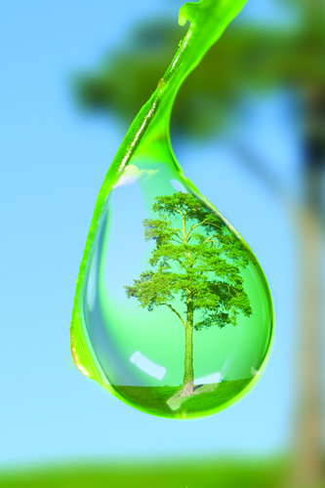
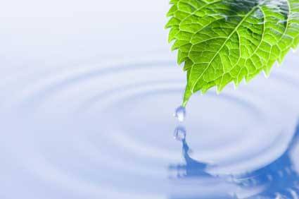
Water is life
Water or H₂O is a chemical substance which contains one oxygen and two hydrogen atoms connected by covalent bonds. But for humans and other lifeforms water means much more. Clean drinking water is essential to every being on Earth.
Water covers 70,9% of Earth’s surface. But freshwater makes up only 3% of it, the rest is contained in oceans. Approximately 70% of freshwater is consumed by agriculture.

Slide 3
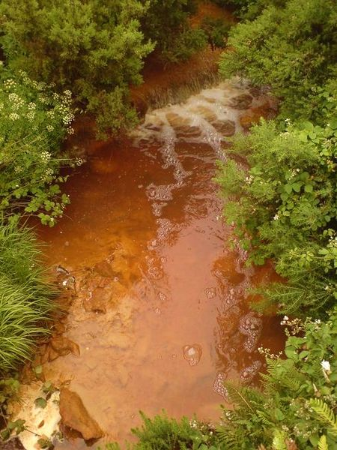
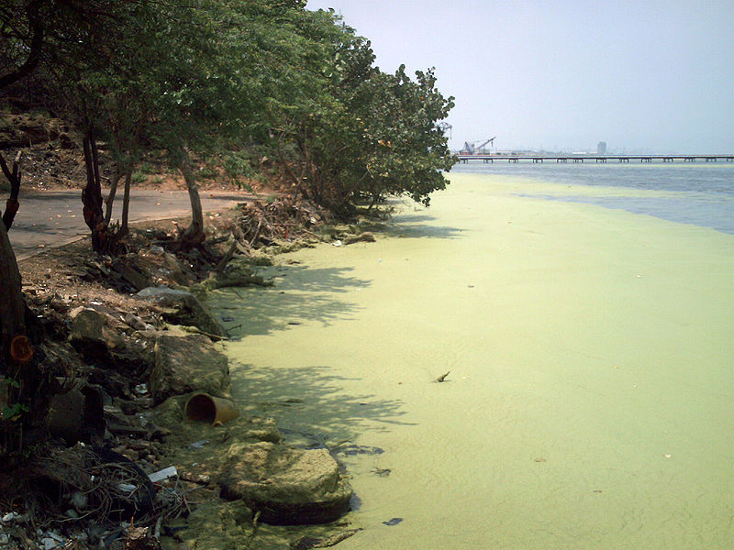
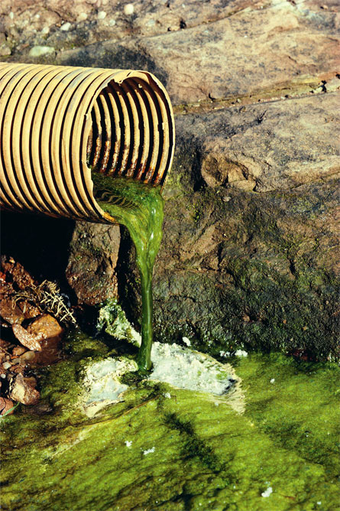
What is water pollution?
It’s any chemical, physical or biological change in the quality of water that has a harmful effect on any living thing that drinks or uses or lives in it.
When humans or animals drink polluted water it often has serious effects on their health. Water pollution can also make water unsuited for desired use.

Slide 4
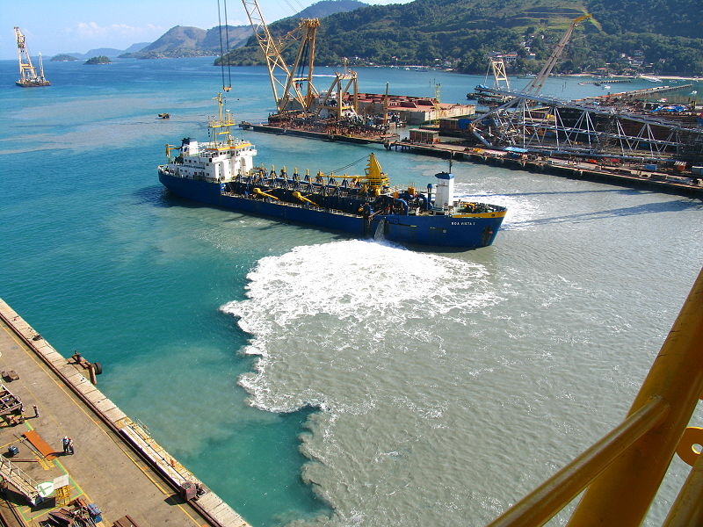
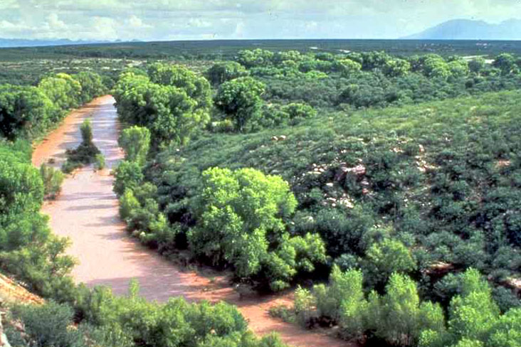
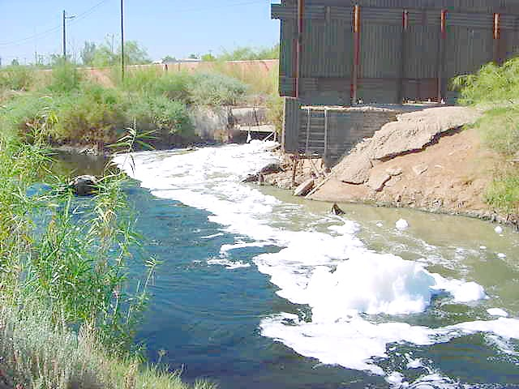
The causes of water pollution
Water pollution is usually caused by human activities. Different sources add to the pollution of water.

Slide 5
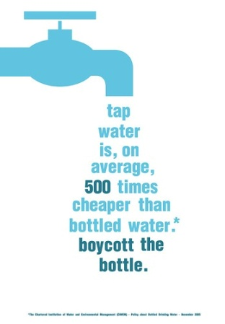
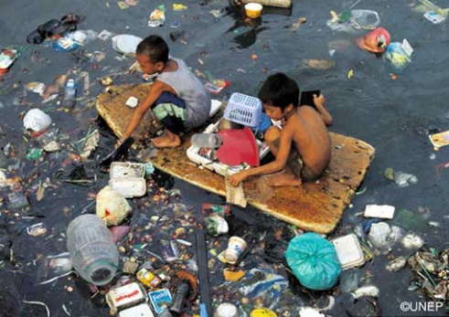
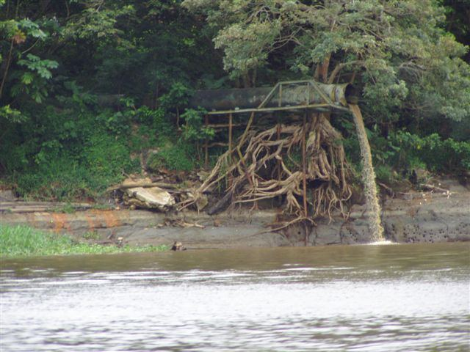
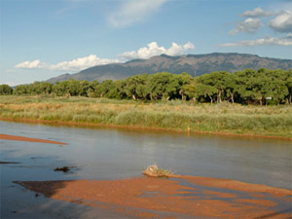
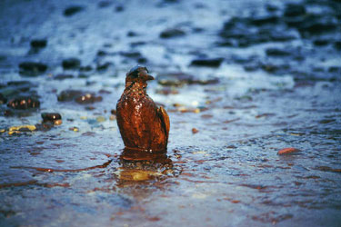
The causes of water pollution are:
sewage and waste water,
marine dumping,
radioactive waste,
industrial waste,
oil pollution,

Slide 6
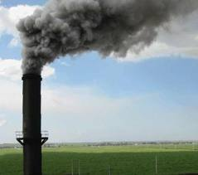
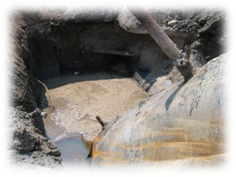
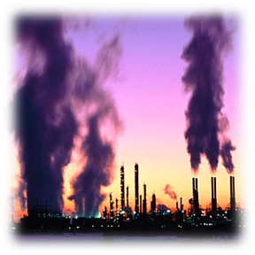
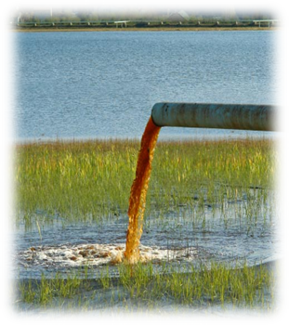
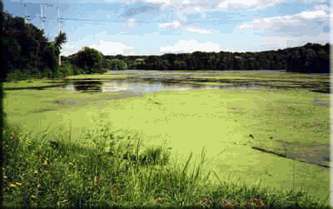
underground storage leakages,
atmospheric decomposition,
global warming (thermal pollution),
eutrophication,
chemicals (chemical pollution).

Slide 7
Types of water pollution

Slide 8
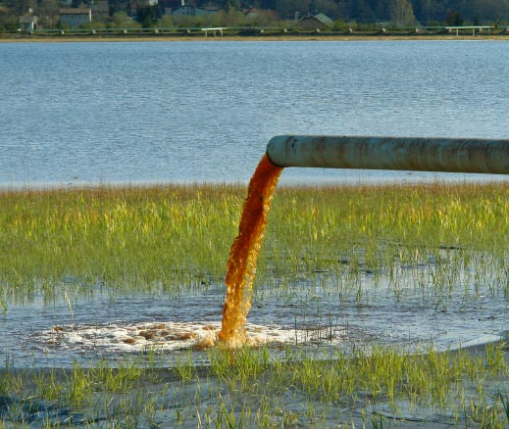
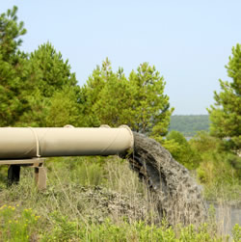
Toxic Substance
A toxic substance is a chemical pullutant that is not a naturally occuring substance in aquatic ecosystems. The greatest contributors to toxic pollution are herbicides pesticides and industrial compounds.

Slide 9
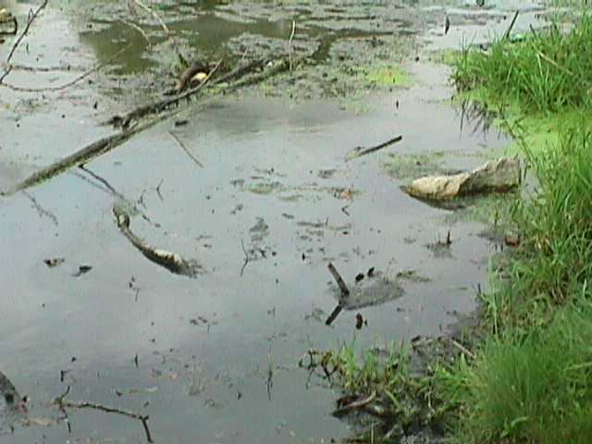
Organic Substance
Organic pollution occurs when an excess of organic matter, such as manure or sewage enters the water. This can cause abnormal plant growth. Organic pollution can cause eutrophication.

Slide 10
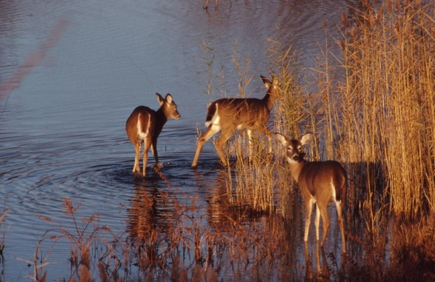
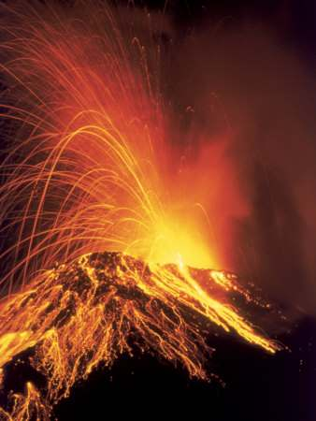
Ecological Pollution
Ecological pollution takes place when chemical pollution, organic pollution or thermal pollution are caused by nature, not by human activity.

Slide 11
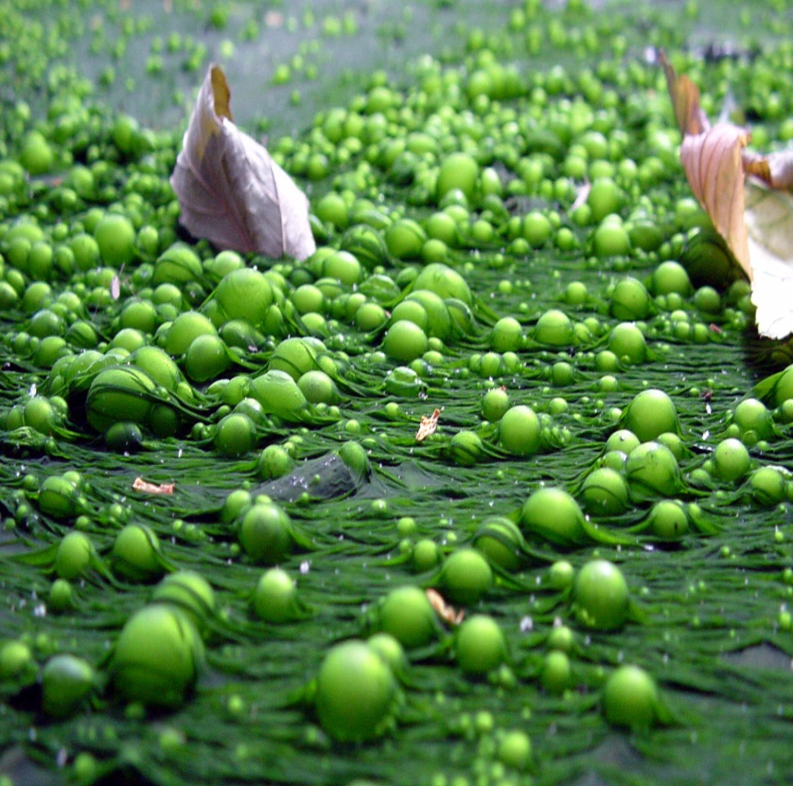
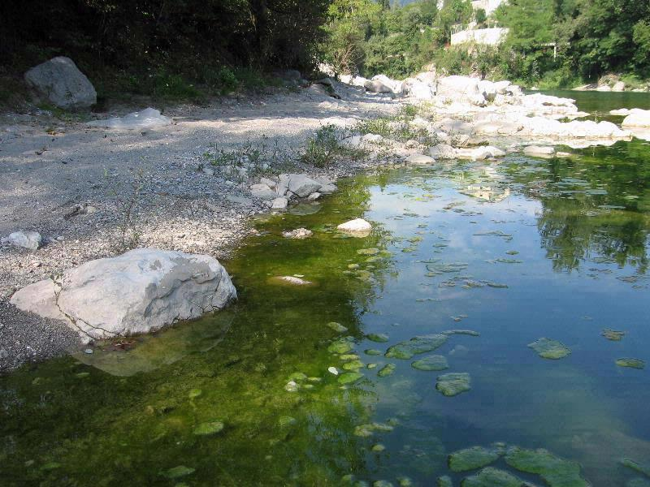
Eutrophication
When the excess plant life caused by organic pollution dies, it becomes organic material in the water. The enormous decay of this plant matter, in turn, lowers the oxygen level.
The process of rapid plant growth followed by increased activity of decomposers and a depletion of the oxygen level is called eutrophication.

Slide 12
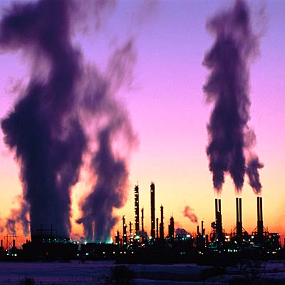
Thermal Pollution
Thermal polution can have a disasterous effect on life in an aquatic ecosystem. As temperature increases, the amount of oxygen in the water decreaces, thereby reducing the number of animals that can survive there.

Slide 13
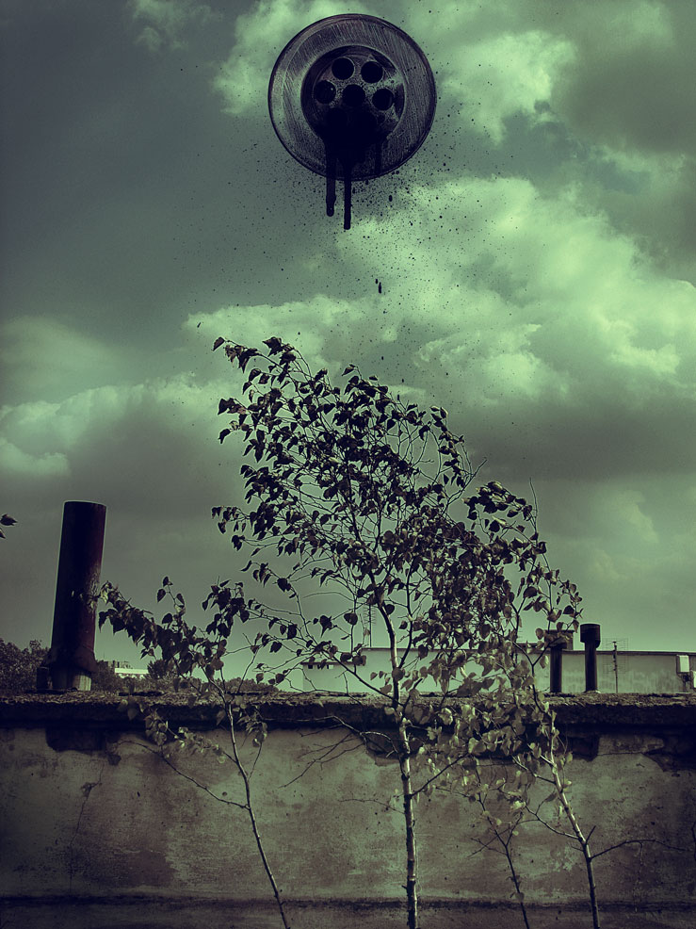
Acid Rain
Typical rainwater has a pH about 5 to 6 (naturally neutral). The industry now emits great amounts of acidifying gasses, such as sulphuric oxides and carbon monoxide.
These gasses can dissolve in rainwater. Because of that the pH of rain will fall to a value of below 4.
The lower the pH, the more acid the substance is. That’s why this kind of rain is called acid rain.

Slide 14
Sources of water pollution

Slide 15
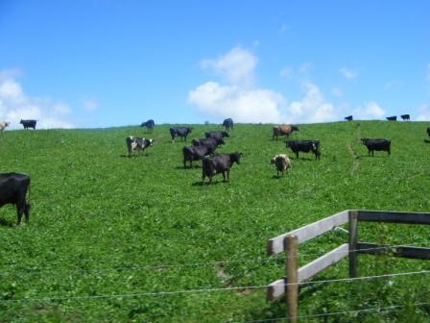
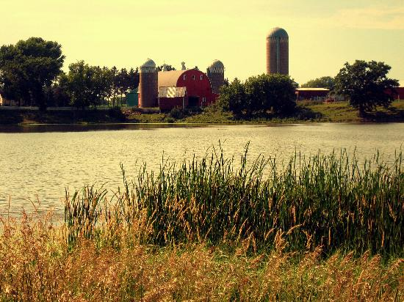
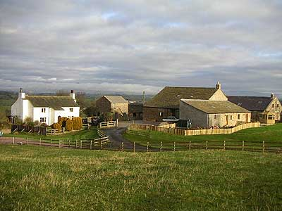
Farming
Farms often use large amounts of herbicides and pesticides, both of which are toxic pollutants.
Farms also frequently use large amounts of chemical fertilizers that are washed into the waterways and damage the water supply and life within it.

Slide 16
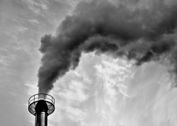
Business
Clearing of land can lead to eriosion of soil into rivers and lakes.
Waste and sewage generated by industry can get into the water supply, introducing large ammounts of organic pollutants into the ecosystem.
Many industrial and power plants use rivers, streams and lakes to despose of waste heat. The resulting hot water can cause thermal pollution.

Slide 17
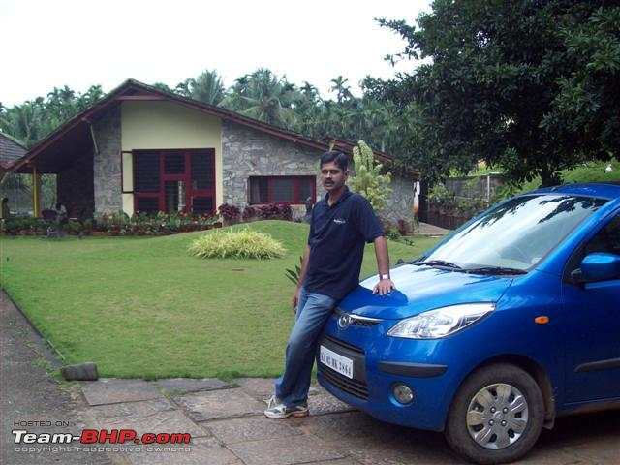
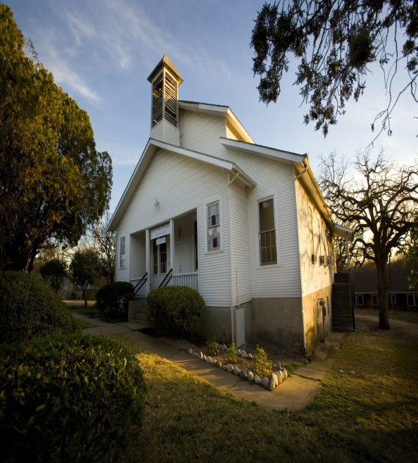
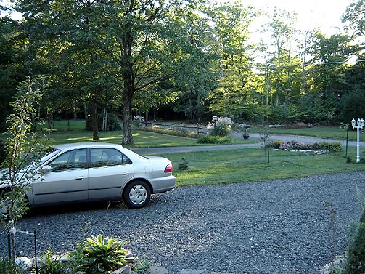
Homes
Sewage generated by houses flows into nearby waterways, introducing organic pollutants that can cause eutrophication.
Fertilizers, herbicides and pesticides used for lawn care can runoff and contaminate the waterways. It can cause eutrophication of lakes and rivers.
Leaks of oil and antifreeze from a car on a driveaway can be washed off by the rain into nearby waterways. Every year, between 1 and 10 bilions tons of oil are spilt, killing many species and destroying ecosystems in the affected area.

Slide 18
Effects of water pollution

Slide 19
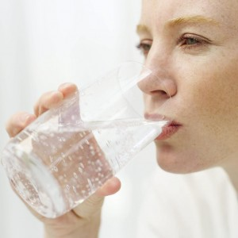
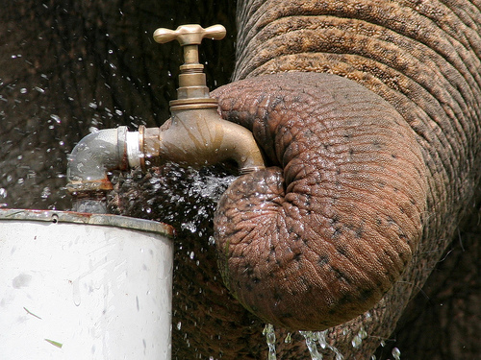
Our health
Virtually all types of water pollution are harmful to the health of humans and animals. Water pollution may not damage our health immediately but can be harmful after long term exposure.

Slide 20
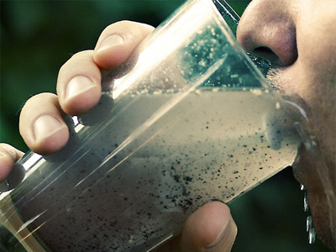
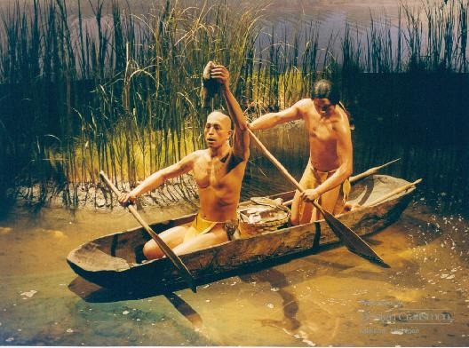
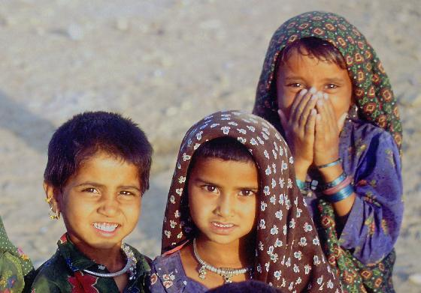
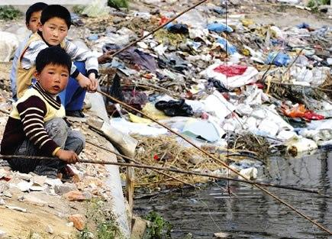
Water pollution is a major problem in the global context. It has been suggested that is the leading worldwide cause of death and disease.
In whole world more than 14,000 people die daily due to water pollution.
700,000,000 Indians have no access to a proper toilet.
1,000 Indian children die of diarrheal sickness every day.
About 90% of China’s cities suffer from some degree of water pollution.
500,000,000 people lack access to safe drinking water.

Slide 21
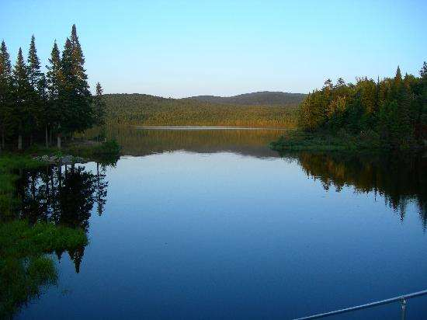
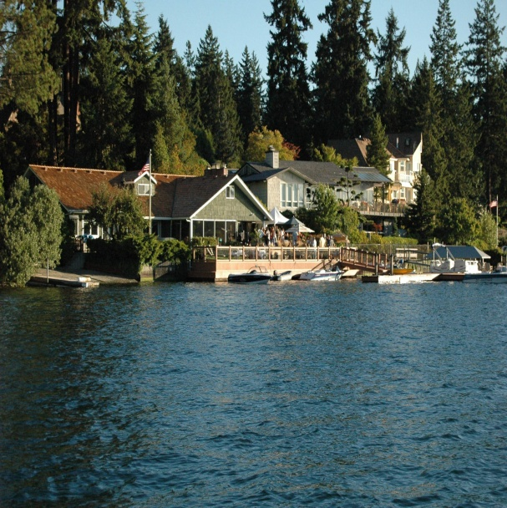
How is it in USA?
For example in 2002 45% of assessed stream miles, 47% of assessed lake acress and 32% of assessed bay and estuarine square miles in the USA were classified as polluted.
(from http://en.wikipedia.org)

Slide 22
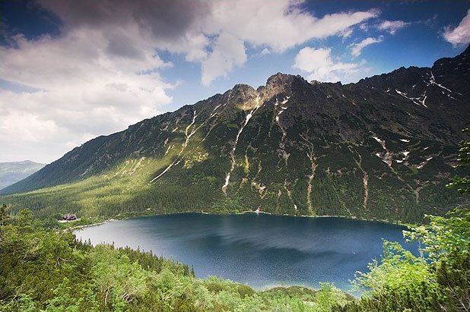
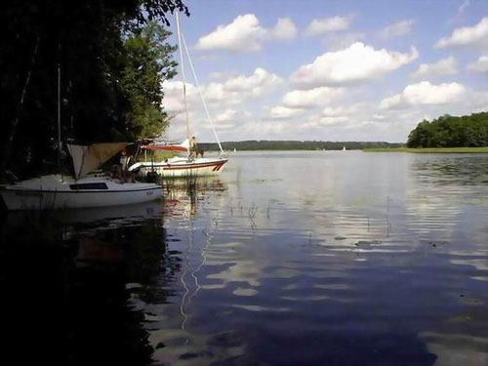
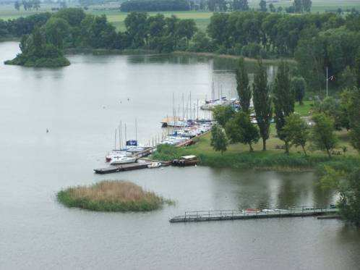
How is it in Poland?
The assessment of water quality in Polish lakes in 2002:
5,8% - first category
39,2% - second category
40,8% - third category
14,2% - unsuited to use
(from http://pl.wikipedia.org)

Slide 23
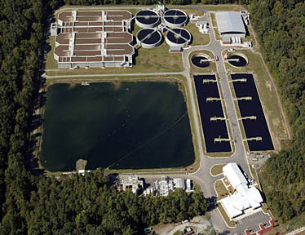
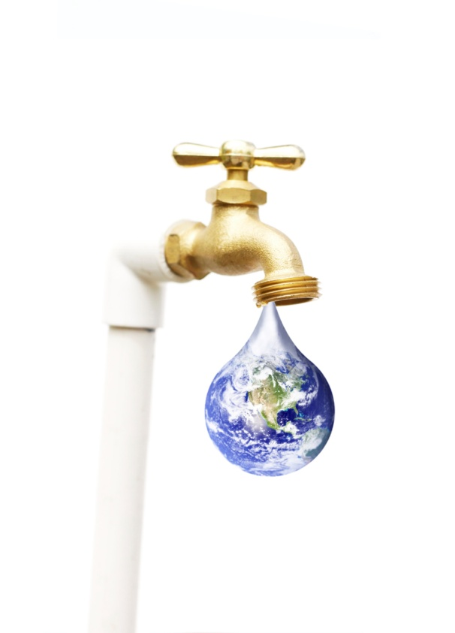
How can we protect our water?
One way is wastewater treatment during which sewage contaminants are removed in order to minimize detrimental impacts on surface water or land. Physical, biological and chemical processes are used for wastewater treatment.
To save our water we should be careful about what we throw down our sink or toilet.
We also can’t throw litter into rivers, lakes or oceans instead of dustbins.
We should take great care not to overuse pesticides and fertilisers.
Pollution of water can also be prevented by the rational use of water.

Slide 24
The end

